Slide 1
Summer Olympic

Slide 2

01 . Does Hosting the Olympics Improve Performance?
02 . Developing a Machine Learning Model for Medal Prediction

Slide 3
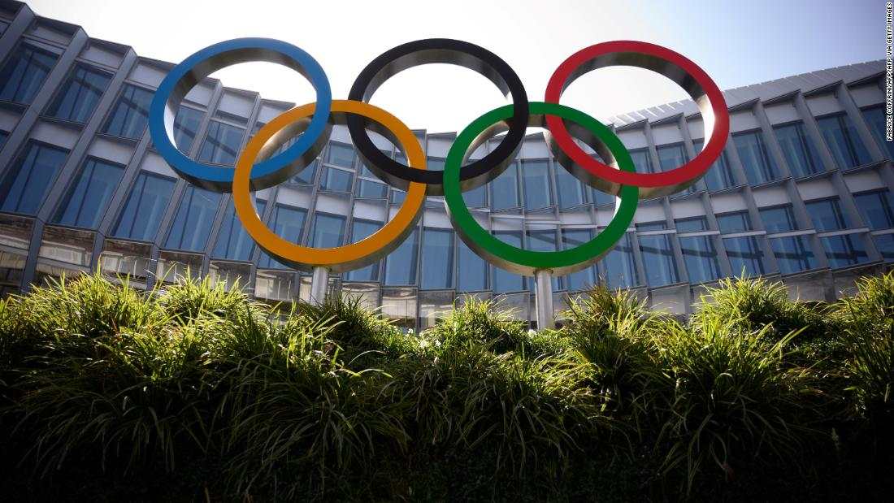
Does Hosting the Olympics Improve Performance?
Does hosting the Olympics boost a country's performance? This theme explores whether factors like home advantage and increased investment lead to more medals for host nations, or if other factors have a greater influence on success.
To explore this question, I will use SQL Server for data joining and cleaning, combining Olympic performance data with factors like host status For visualizations, I will use Tableau to present clear, impactful insights into how hosting affects medal counts, allowing for easy comparison and trend analysis.

Slide 4
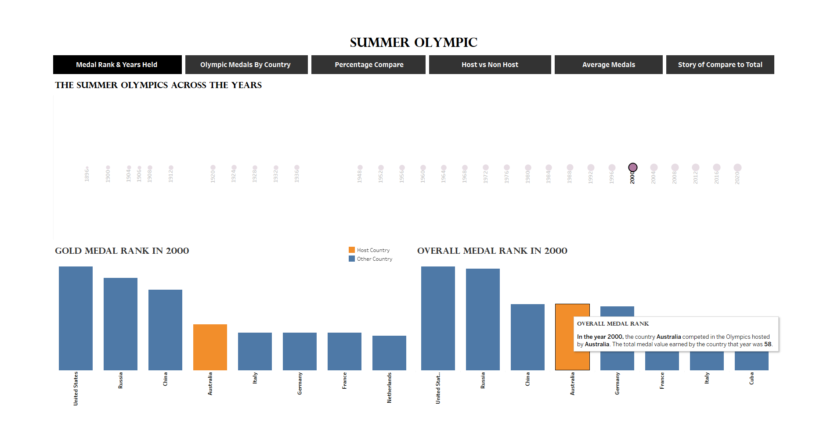
Gold Medal Rank , Overall Medal Rank & Years

Slide 5
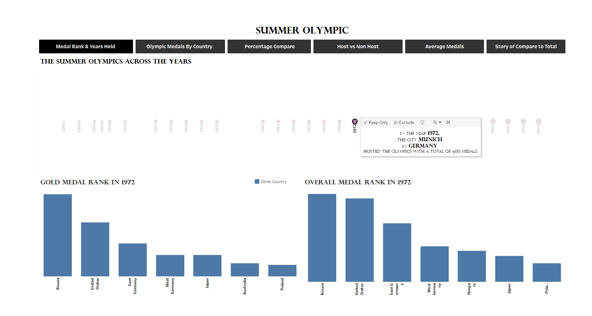
Gold Medal Rank , Overall Medal Rank & Years

Slide 6
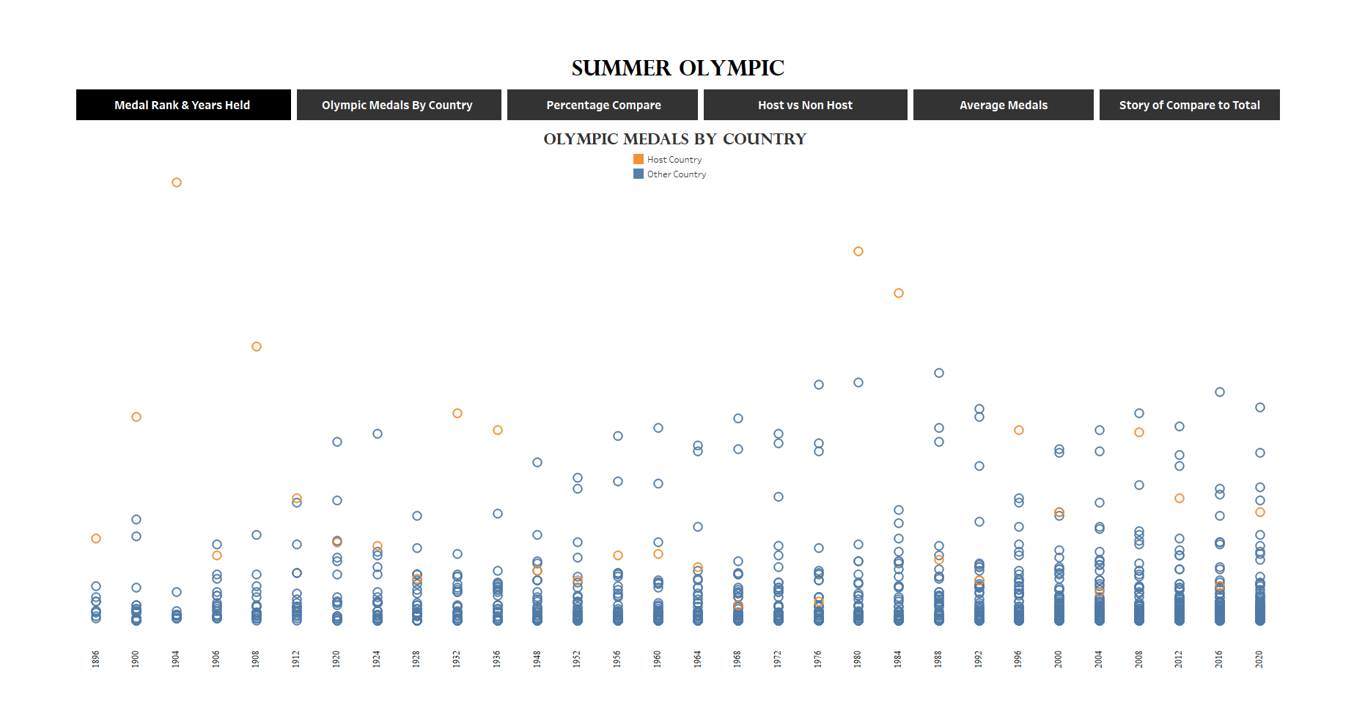
Olympic Medals By Country

Slide 7
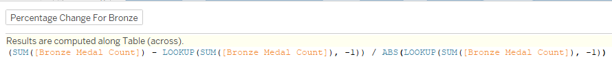
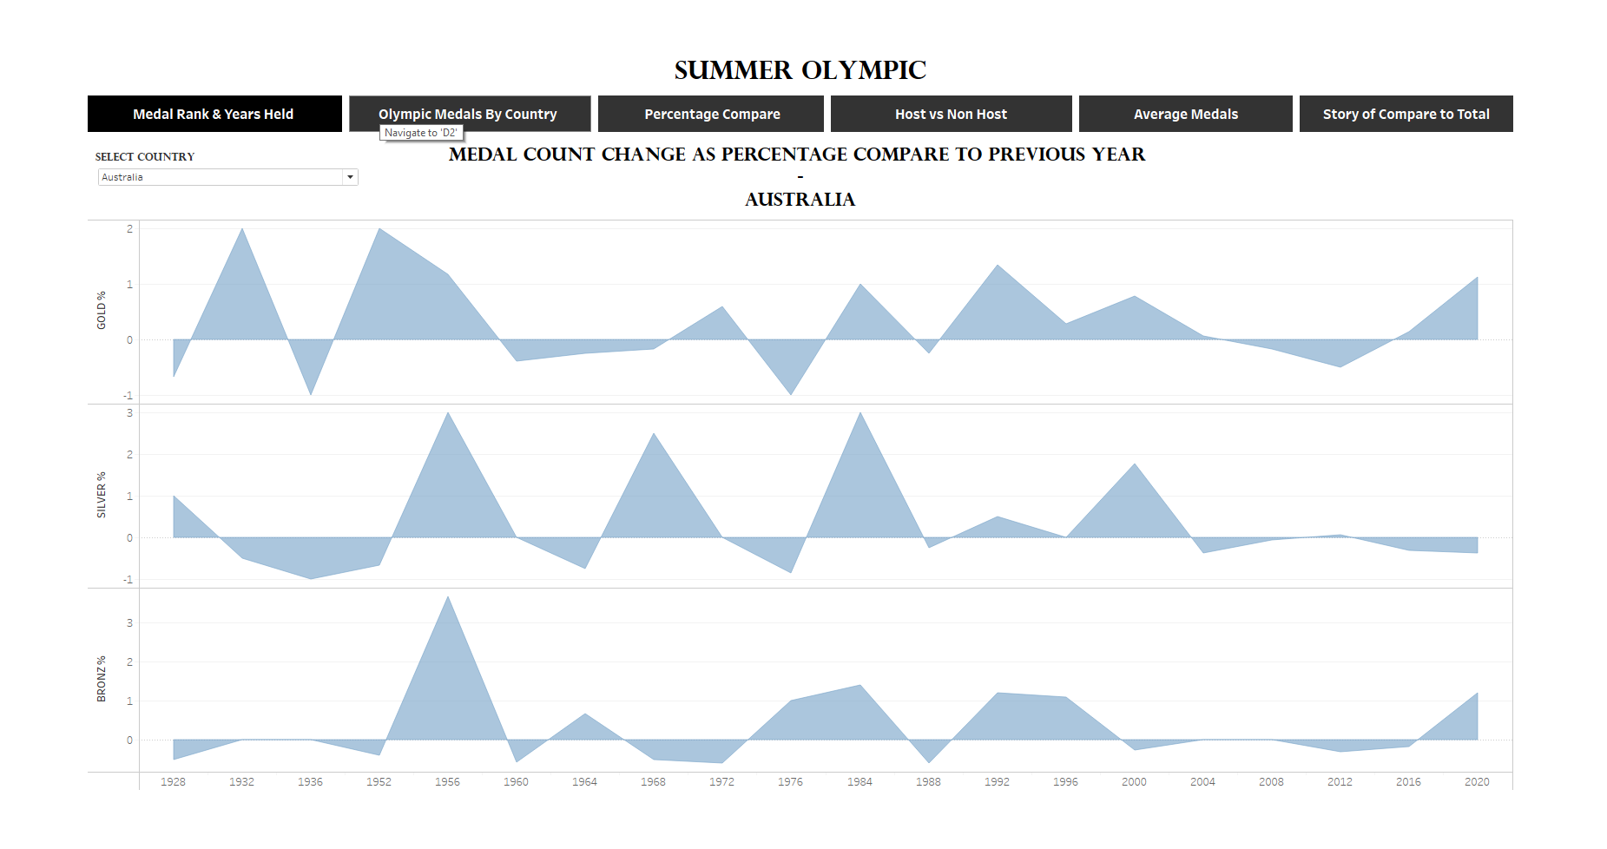
Medal Percentage Compare

Slide 8
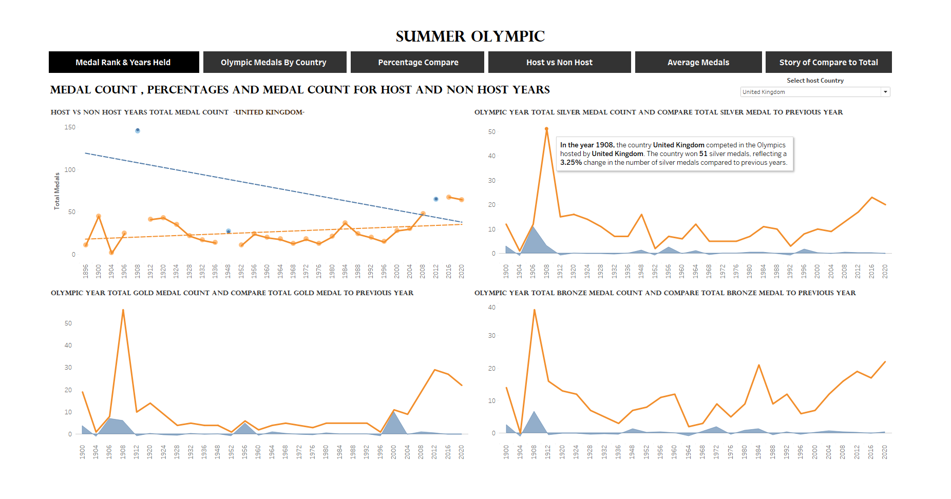
Host Vs Non Host

Slide 9
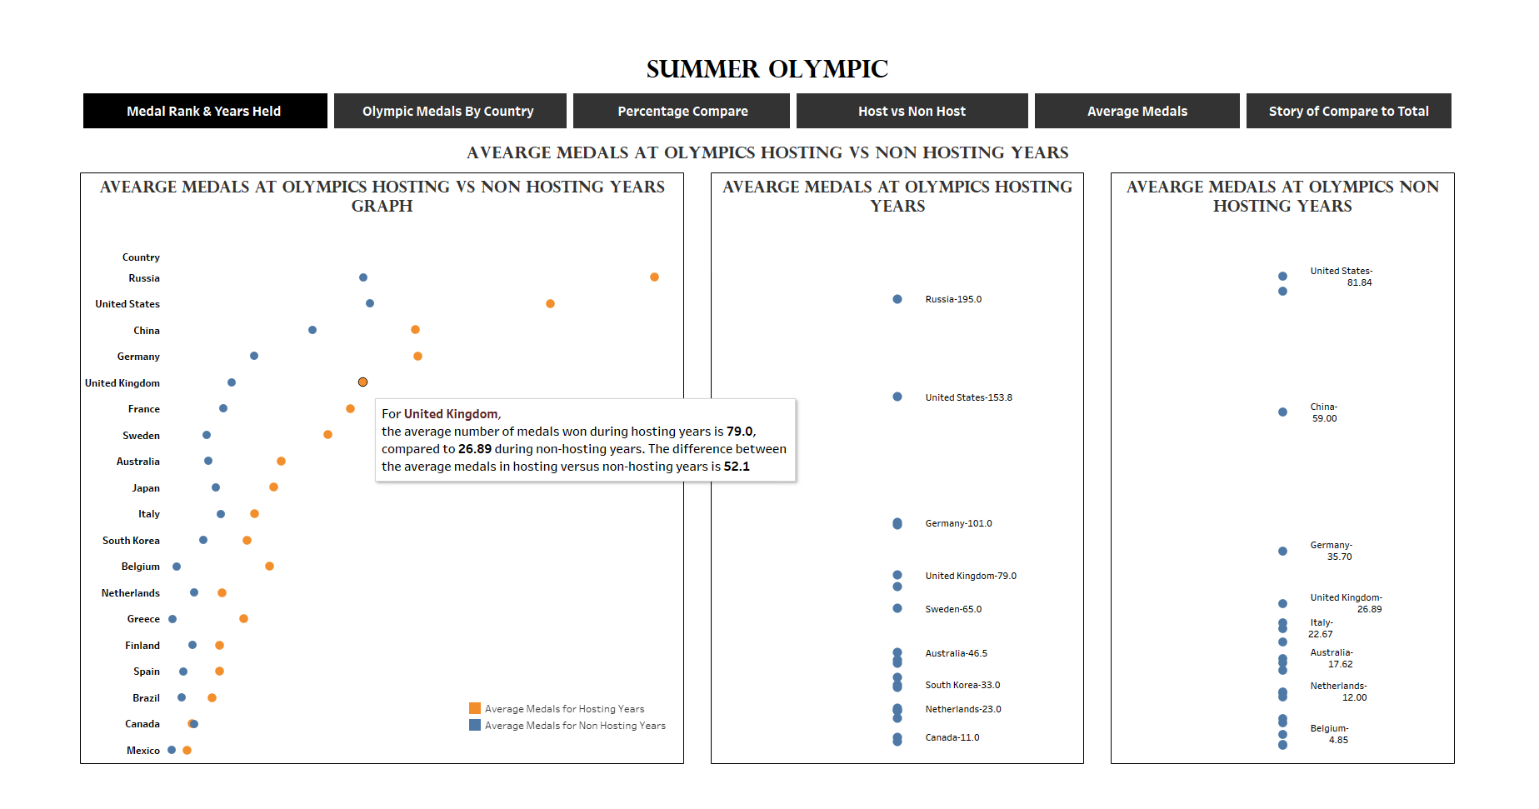
Average Medal Count Compare Host and Non Host Years

Slide 10
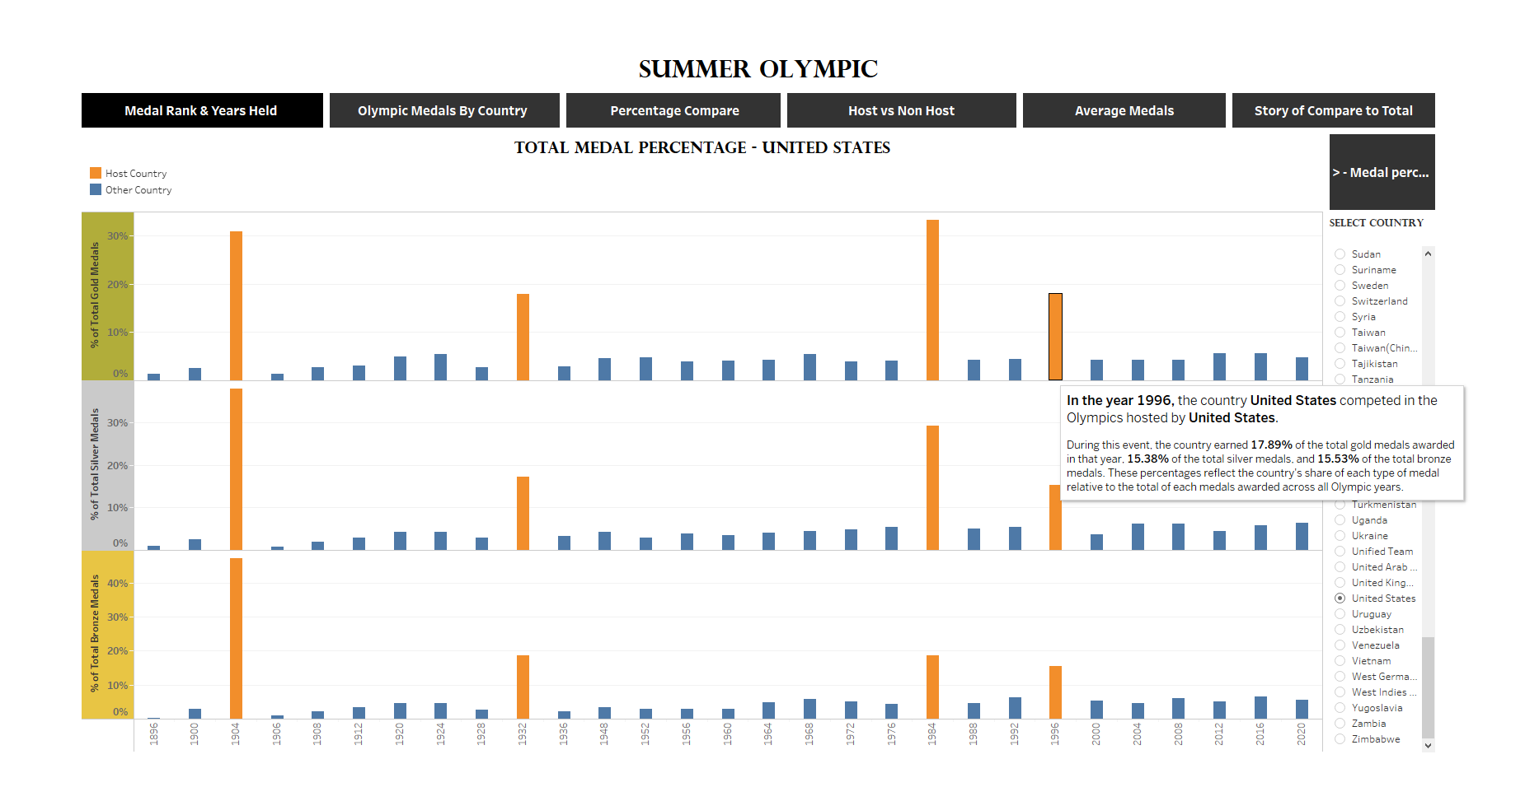
Compare To Total

Slide 11
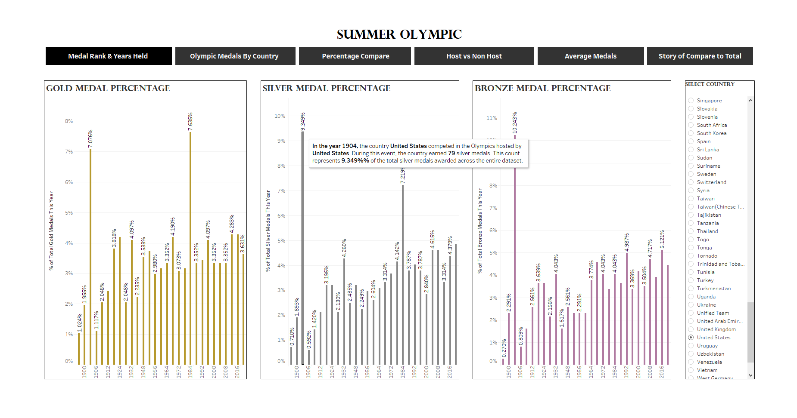
Compare To Total

Slide 12
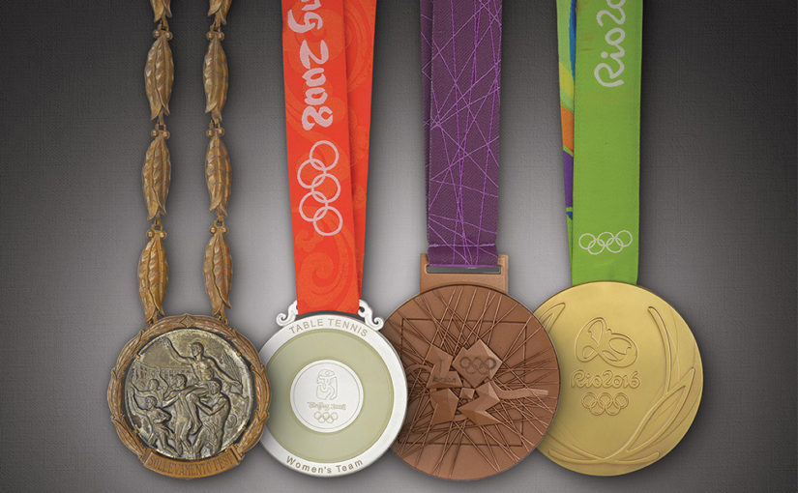
Developing a Machine Learning Model for Medal Prediction
Developing a machine learning model for medal prediction aims to forecast how many medals a country might win based on various factors. By using historical Olympic data, I will train the model with features such as a country's previous performance, economic indicators, population, and whether they are hosting.
This approach helps identify patterns and trends, allowing for more accurate medal predictions for future Olympics. Through this process, I will evaluate model accuracy and refine predictions to better understand the key drivers of Olympic success.

Slide 13
Data Selection and Splitting:
Selected Data Range: 1992 to 2020
Reasoning: Chose this range to include data from after the dissolution of the Soviet Union (which ended in 1991) to ensure consistent country identifiers and data accuracy.
Training Set: 1992 to 2016
Purpose: To build the model using historical data and trends up to the 2016 Olympics.
Test Set: 2020
Purpose: To evaluate the model’s performance and predictive accuracy on the most recent Olympic data.

Slide 14
Features Plan to Use:
Demographic and Economic Indicators:
Total Population
Population Growth
GNI per Capita
GDP
GDP Growth
GDP per Capita
% World Population
% World GDP
Year
Olympic-Specific Metrics:
Total Athletes Each Year By Country
Total Events Each Year By Country
Host Country Status (Host or Not)
Geographical and Developmental Factors:
Region
HDI (Human Development Index)
Dependent Variable (Y):
Total Medals Each Year By Country

Slide 15
Additional Consideration:
Political System: Exploring the impact of political stability on medal wins. Considering the World Bank's Political Stability score as a potential feature. This score reflects government effectiveness and stability, which might influence athletic performance.
Integrating the Political Stability score effectively, given that it may not directly measure political systems but can serve as an indirect indicator of political conditions.
Further Analysis of Region:
I included Region as a feature, considering that climate, environment, and technology might impact performance and medal counts. However, with athletes often moving to other countries for better training, I will further analyze whether these factors should be integrated into the model or if their relevance is diminished due to current athlete relocation trends.

Slide 16
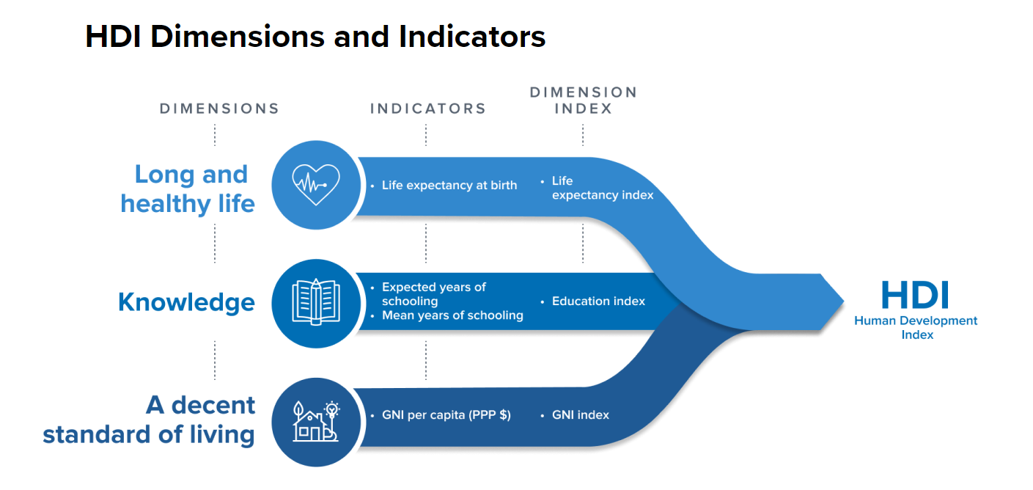
The Human Development Index (HDI) is a composite statistic used to assess and compare the overall development and well-being of countries.

Slide 17
Gross National Income (GNI) per capita is a measure of a country's average income per person, adjusted for purchasing power parity (PPP). It reflects the total income earned by a country’s residents, including any income from abroad, divided by the total population.
I want to check if there is a correlation between HDI and GNI per capita because GNI per capita is an indicator used in calculating HDI. If a strong correlation exists, it might affect the model's effectiveness

Slide 18
Initial Data
Data columns (total 20 columns)
float64(7), int64(10), object(3)
Column | Data Count | non-null / null | Data Type
Year | 626 | non-null | int64
Country | 626 | non-null | object
Total_Medals | 626 | non-null | int64
Gold_Medals | 626 | non-null | int64
Silver_Medals | 626 | non-null | int64
Bronze_Medals | 626 | non-null | int64
Total_Athletes | 626 | non-null | int64
Events_Count | 626 | non-null | int64
Host_or_Not | 626 | non-null | int64
Country_Code | 626 | non-null | object
population_total | 626 | non-null | int64
population_growth | 626 | non-null | float64
GNI_per_capita | 626 | non-null | int64
GDP | 626 | non-null | float64
GDP_growth | 626 | non-null | float64
Region | 626 | non-null | object
GDP_per_capita | 626 | non-null | float64
Population_Percentage | 626 | non-null | float64
GDP_Percentage | 626 | non-null | float64
HDI | 626 | non-null | float64

Slide 19
Region
Host Or Not
East Asia and Pacific
Europe and Central Asia
Latin America and Caribbean
Middle East and North Africa
North America
South Asia
Sub-Saharan Africa
Host = 1
Not = 0
Convert All Numeric Fields Data type to Float

Slide 20
Exploratory Data Analysis (EDA)

Slide 21
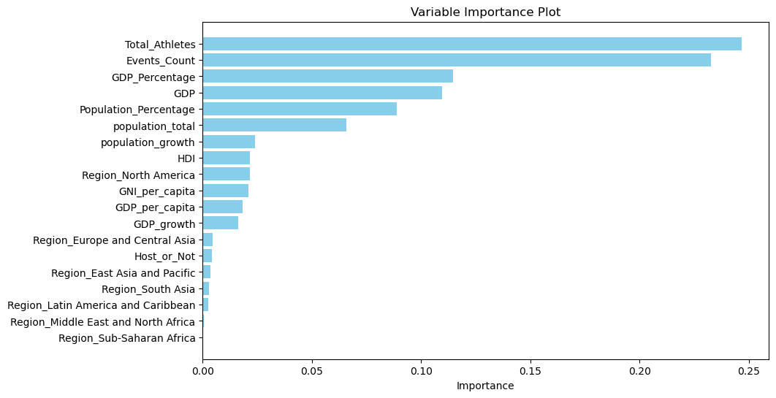
01). Variable Importance Plot – Random Forest Regressor

Slide 22
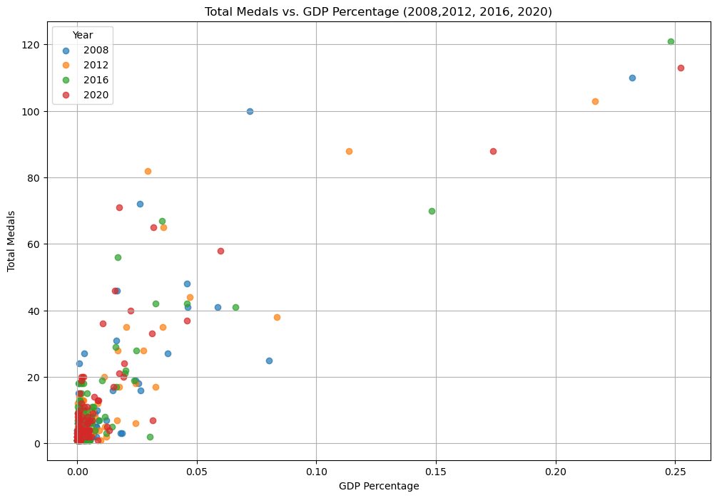
02). Total Medals vs. GDP Percentage (2008,2012, 2016, 2020)

Slide 23
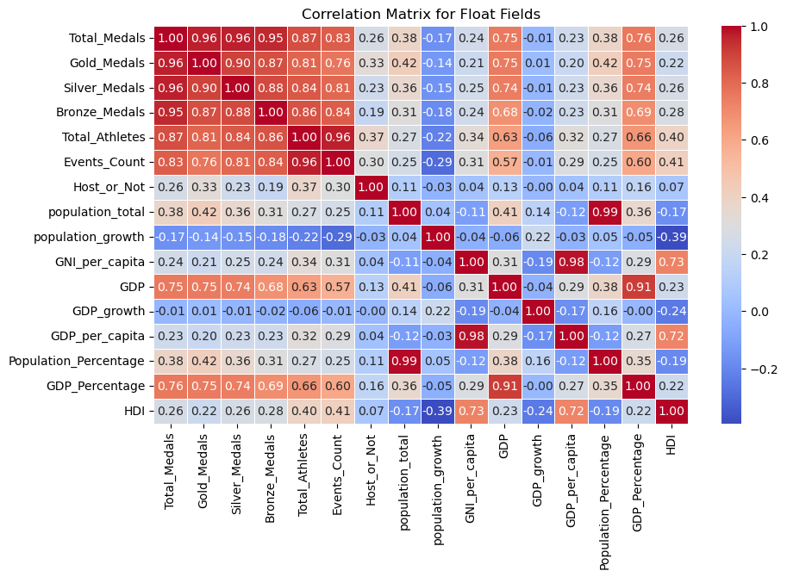
03). Correlation Matrix

Slide 24
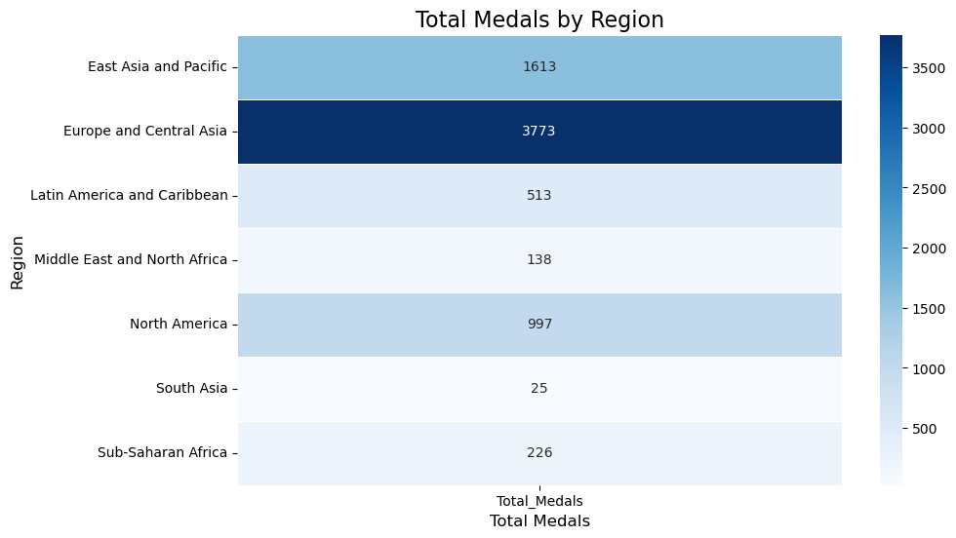
04). Total Medals by Region

Slide 25
Machine Learning Model

Slide 26
Phase 01
Feature Scaling :
Z – Score Scaled -
'population_total‘ , 'population_growth ', 'GNI_per_capita‘ , 'GDP‘ ,‘ GDP_growth‘ , ‘GDP_per_capita', 'Population_Percentage‘ , 'GDP_Percentage‘ , 'HDI‘
One-Hot Encoded –
'Region'
Models :
‘Linear Regression': LinearRegression(),
'Ridge': Ridge(),
'Lasso': Lasso(),
'Poisson': PoissonRegressor(),
'Random Forest': RandomForestRegressor(n_estimators=100, random_state=42),
'Support Vector Regression': SVR(kernel='linear')
X Train Columns :
'Total_Athletes‘ , 'Events_Count‘ , 'Host_or_Not‘ , 'population_total‘ , 'population_growth‘ , 'GNI_per_capita‘ , 'GDP‘ , 'GDP_growth‘ , 'Region‘ , 'GDP_per_capita‘ , 'Population_Percentage‘ , 'GDP_Percentage‘ , 'HDI'

Slide 27
Model | Train MSE | Test_R2
Linear Regression | 115.860113 | 0.702645
Ridge | 116.267909 | 0.700717
Lasso | 134.060115 | 0.687466
Poisson | 155.43979 | 0.145245
Random Forest | 11.466192 | 0.854375
SVR | 138.77008 | 0.669613
Country | Actual Total Medals | Linear Regression | Ridge | Lasso | Poisson | Random Forest | Support Vector Regression
United States | 113 | 140.538222 | 138.178321 | 129.958261 | 149.295001 | 113.7 | 133.023632
China | 88 | 104.656628 | 108.654256 | 102.37808 | 210.189533 | 83.58 | 100.940126
Japan | 58 | 38.199706 | 37.7423 | 38.19935 | 24.991964 | 40.95 | 33.220111
United kingdom | 65 | 27.405588 | 27.0314 | 23.770888 | 21.813028 | 47.31 | 21.361607
Russian Olympic Committee | 71 | 21.248297 | 21.521613 | 17.729284 | 17.631368 | 45.36 | 15.42964

Slide 28
Phase 02
Feature Scaling :
Z – Score Scaled -
'population_total‘ , 'population_growth ', 'GNI_per_capita‘ , 'GDP‘ ,‘ GDP_growth‘ , ‘GDP_per_capita', 'HDI‘
One-Hot Encoded -
'Region‘
Population_Percentage and GDP_Percentage features are not normalized and used in their original form
Models :
‘Linear Regression': LinearRegression(),
'Ridge': Ridge(),
'Lasso': Lasso(),
'Random Forest': RandomForestRegressor(n_estimators=100, random_state=42),
'Support Vector Regression': SVR(kernel='linear')
Special Conditions :
01). Predicted medals must be integers.
02). No negative values; minimum is 0.

Slide 29
Get results for the Z-Score normalized target value of total medals and the original target value of total medals.
Model | Normalization | RMSE | MSE | R^2
Linear Regression | Without Normalized Y | 7.195084 | 51.769231 | 0.858774
Linear Regression | Normalized Y | 7.195084 | 51.769231 | 0.858774
Lasso | Without Normalized Y | 7.00157 | 49.021978 | 0.866268
Lasso | Normalized Y | 19.146916 | 366.604396 | -0.000095
Ridge | Without Normalized Y | 7.378317 | 54.43956 | 0.851489
Ridge | Normalized Y | 7.088142 | 50.241758 | 0.862941
SVR | Without Normalized Y | 16.597696 | 275.483516 | 0.248482
SVR | Normalized Y | 9.876713 | 97.549451 | 0.733886
RandomForest | Without Normalized Y | 6.215012 | 38.626374 | 0.894627
RandomForest | Normalized Y | 6.028321 | 36.340659 | 0.900863

Slide 30
Get results for the Z-Score normalized target value of total medals and the original target value of total medals.
Country | Actual | LR | Lasso | Ridge | SVR | Random Forest | LR Normalized | Lasso Normalized | Ridge Normalized | SVR Normalized | RF Normalized
USA | 113 | 128 | 118 | 127 | 12 | 114 | 128 | 12 | 127 | 65 | 114
CHN | 88 | 90 | 85 | 99 | 12 | 56 | 90 | 12 | 92 | 49 | 58
JPN | 58 | 64 | 68 | 65 | 19 | 55 | 64 | 12 | 63 | 37 | 54
GBR | 65 | 41 | 40 | 40 | 17 | 44 | 41 | 12 | 40 | 29 | 44
ROC | 71 | 33 | 33 | 35 | 23 | 48 | 33 | 12 | 34 | 37 | 49
AUS | 46 | 46 | 46 | 46 | 23 | 31 | 46 | 12 | 46 | 39 | 31
NED | 36 | 26 | 26 | 26 | 15 | 20 | 26 | 12 | 25 | 16 | 21
FRA | 33 | 43 | 41 | 43 | 20 | 39 | 43 | 12 | 42 | 30 | 39
GER | 37 | 49 | 47 | 49 | 24 | 38 | 49 | 12 | 48 | 36 | 38
ITA | 40 | 37 | 37 | 37 | 18 | 31 | 37 | 12 | 37 | 27 | 30

Slide 31
Phase 03
Principal Component Analysis :
GDP and GDP_Percentage
population_total and population_percentage
GNI_per_capita and GDP_per_capita
Events_Count and Total_Athletes
Feature Scaling :
Z – Score Scaled -
'population_growth ',‘ GDP_growth‘ ,, 'HDI‘
One-Hot Encoded –
'Region'
Models :
‘Linear Regression': LinearRegression(),
'Ridge': Ridge(),
'Lasso': Lasso(),
Weighted LR
'Random Forest': RandomForestRegressor(n_estimators=100, random_state=42),

Slide 32
Special Conditions :
01). Predicted medals must be integers.
02). No negative values; minimum is 0.
X Train Columns :
'Host_or_Not', 'GDP_PCA', 'population_PCA', 'income_PCA‘ , 'athletes_PCA‘ , 'population_growth_zscore‘ , 'GDP_growth_zscore‘ ,'HDI_zscore‘ , 'Region_Europe and Central Asia‘ , 'Region_Latin America and Caribbean‘ , 'Region_Middle East and North Africa‘ , 'Region_North America‘ , 'Region_South Asia‘ , 'Region_Sub-Saharan Africa'

Slide 33
Model | R Squared | MSE
LR | 0.86177156 | 55.61400262
Weighted LR | 0.845283674 | 89.33924483
Lasso | 0.871604336 | 61.16156825
Ridge | 0.861201978 | 55.65246288
Random Forest | 0.89240905 | 5.349440748
Without normalize Y
Model | R Squared | MSE
LR | 0.86177156 | 0.160083209
Weighted LR | 0.845613432 | 0.257160289
Lasso | 0.85985297 | 0.167875721
Ridge | 0.860782287 | 0.160193916
Random Forest | 0.896426098 | 0.015145438
With normalize Y

Slide 34
Phase 04
Consider only the Random Forest model.
Use Random Forest with cross-validation and hyperparameter tuning, along with the specified special condition
# Perform cross-validation
cv = KFold(n_splits=5, shuffle=True, random_state=42)
# Initialize the Random Forest model with the best parameters
model = RandomForestRegressor(
n_estimators=500,
max_depth=20,
max_features='sqrt',
min_samples_split=2,
min_samples_leaf=1,
random_state=42
)

Slide 35
Special Conditions :
01). Predicted medals must be integers.
02). No negative values; minimum is 0.
03). Predicted medals must equal actual total medals.
X Train Columns :
'Host_or_Not', 'GDP_PCA', 'population_PCA', 'income_PCA‘ , 'athletes_PCA‘ , 'population_growth_zscore‘ , 'GDP_growth_zscore‘ ,'HDI_zscore‘ , 'Region_Europe and Central Asia‘ , 'Region_Latin America and Caribbean‘ , 'Region_Middle East and North Africa‘ , 'Region_North America‘ , 'Region_South Asia‘ , 'Region_Sub-Saharan Africa'

Slide 36
Model Name | Test Set Multiple R | Test Set R-squared (R²) | Test Set Std. Error | Training Set MSE
Without Condition | 0.943308509 | 0.889830944 | 6.354889093 | 5.001277383
With Condition | 0.945356072 | 0.893698103 | 6.242357965 | 5.349440748
With Condition + Y Normalized | 0.947478312 | 0.897715151 | 6.123275716 | 0.015145438
Condition + Hyper para | 0.954382263 | 0.910845504 | 5.716757707 | 5.327314522
Condition + Hyper para + Y Normalized | 0.95142506 | 0.905209645 | 5.894680038 | 0.015374254
Condition + Cross Validation | 0.945356072 | 0.893698103 | 6.242357965 | 5.349440748
Condition + Cross Validation + Y Normalized | 0.947478312 | 0.897715151 | 6.123275716 | 0.111340807
All combined | 0.954382263 | 0.910845504 | 5.716757707 | 5.327314522
All combined + Y Normalized | 0.950337395 | 0.903141165 | 5.958648715 | 0.016055945

Slide 37
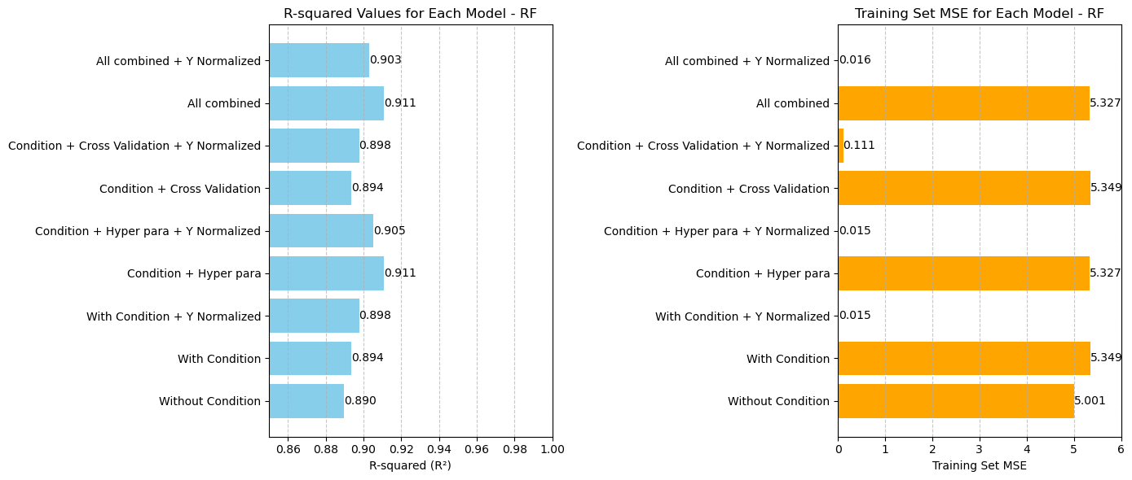

Slide 38
Country | Predicted Medals | Total Medals
United States | 115 | 113
China | 76 | 88
Japan | 64 | 58
United kingdom | 43 | 65
Russia | 48 | 71
Australia | 37 | 46
Netherlands | 21 | 36
France | 39 | 33
Germany | 46 | 37
Italy | 34 | 40

Slide 40
THANK YOU

